Slide 1
Selecting a Platform for Novel Oligonucleotide Clinical Bioanalysis: Assessing Benefits and Challenges
Rebecca Lescarbeau, PhD
OTS 2024

Slide 2
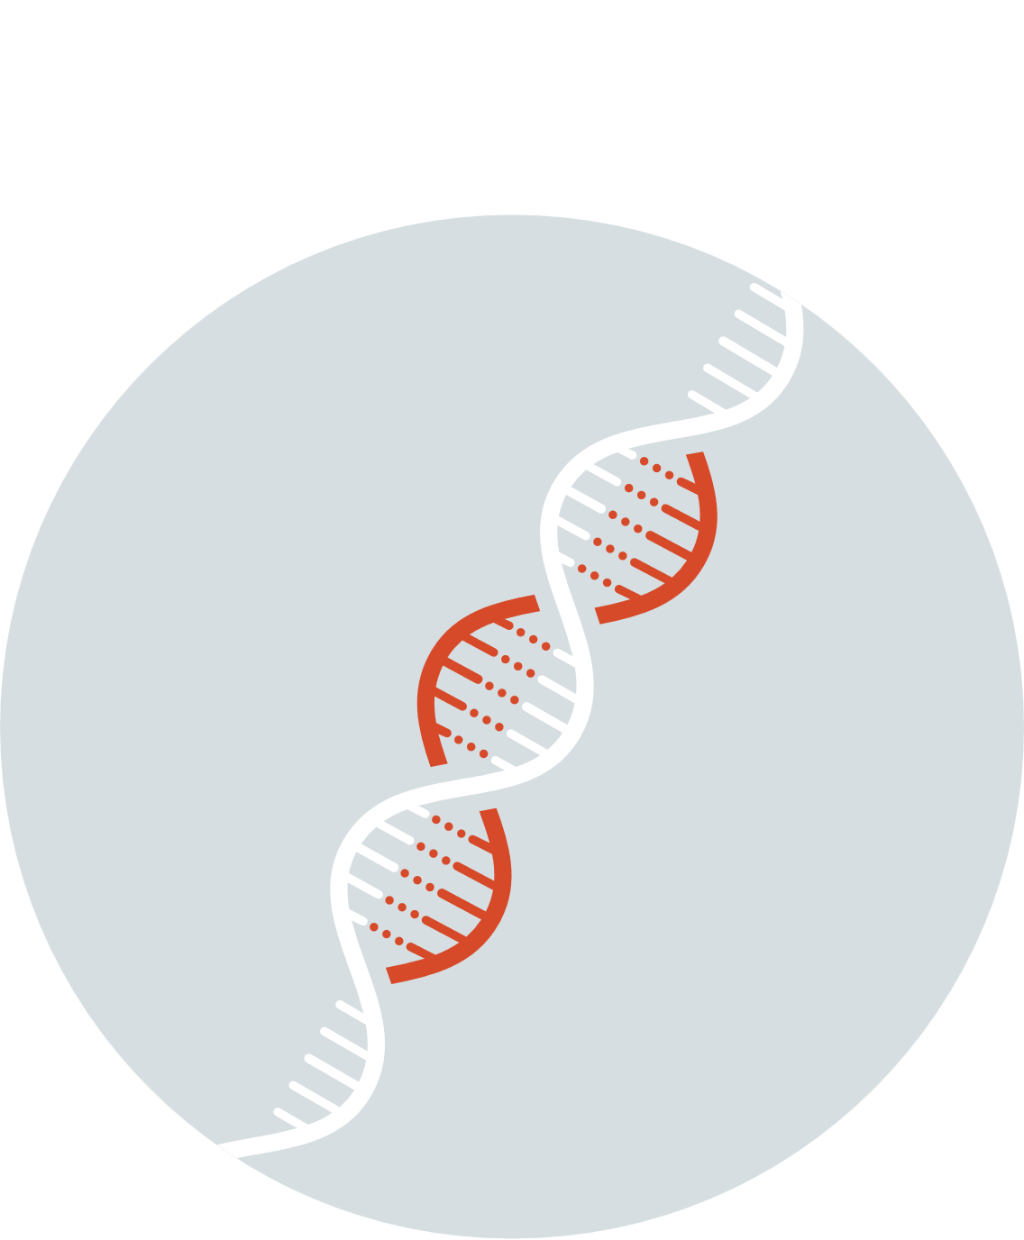


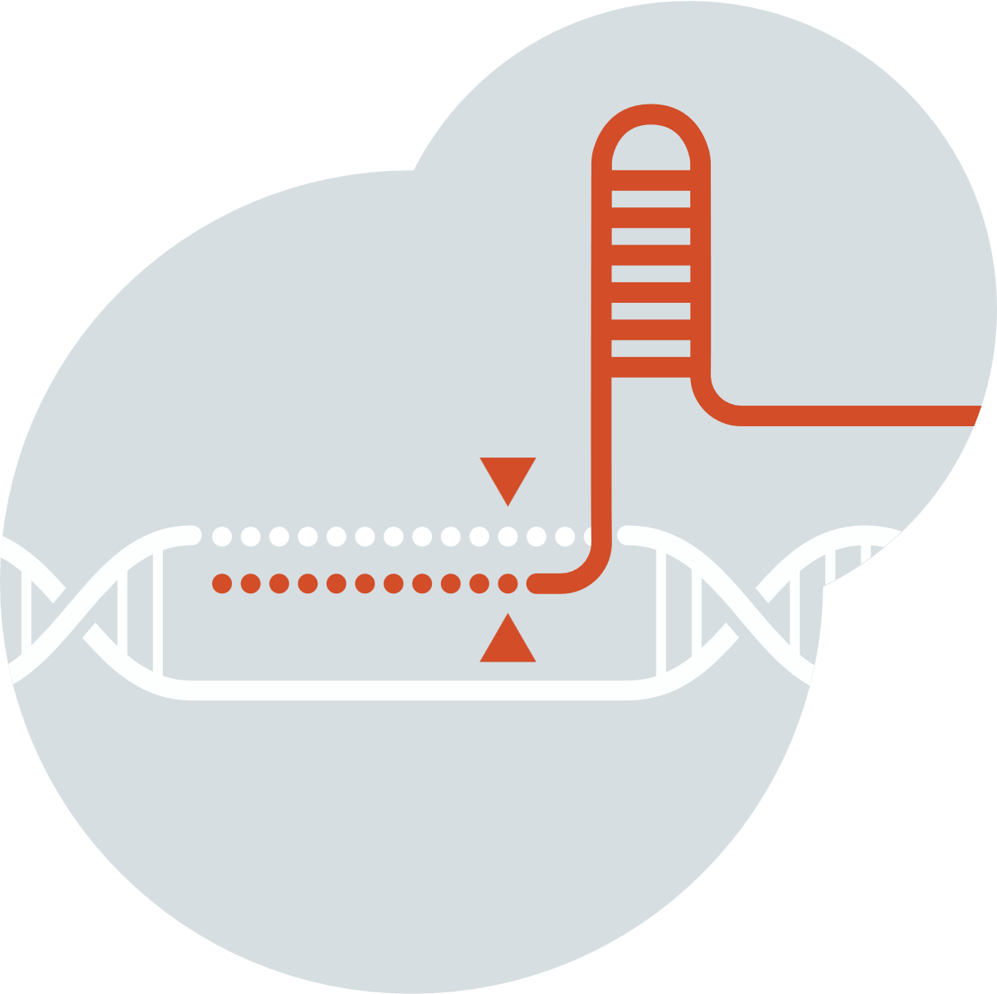



Therapeutic Strategies to Treat Life-Threatening Diseases Have Advanced Over Time
INNOVATION TIMELINE
Small Molecule Drugs
Biologics
RNAi
Gene Therapy
Genome Editing
PROTEINS
RNA
DNA

Slide 3
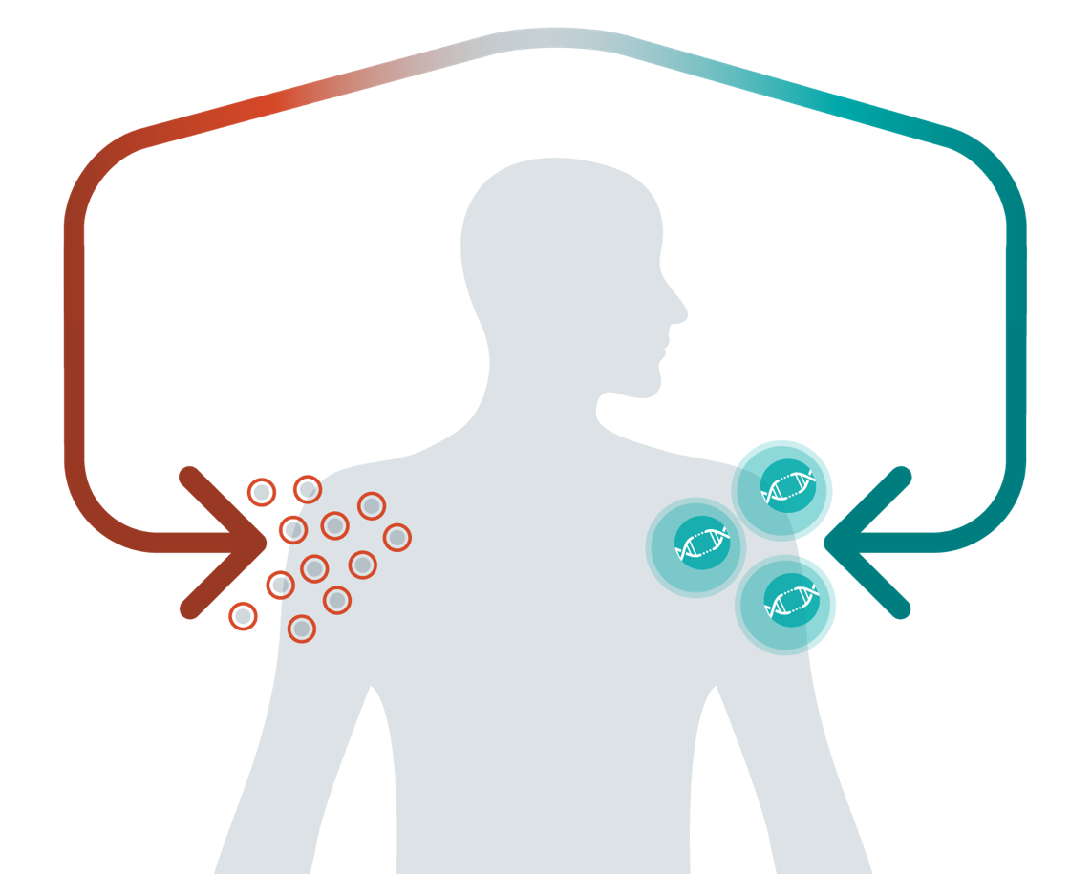
Advancing a Full-Spectrum Genome Editing Company
CRISPR-Based
Modular Platform
EMPLOY NOVEL EDITING AND DELIVERY TOOLS
In Vivo
Ex Vivo
CRISPR is the therapy
CRISPR creates the therapy
FIX THE TARGET GENE
REWIRE & REDIRECT CELLS
Genetic diseases
Immuno-oncology
Autoimmune diseases

Slide 4

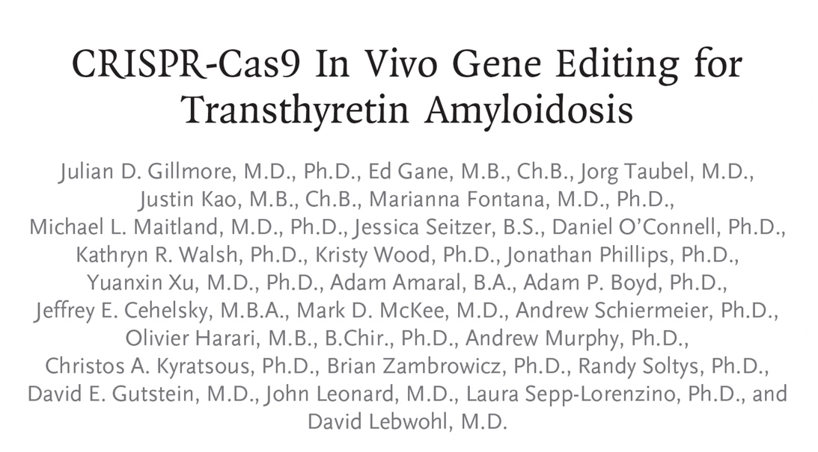
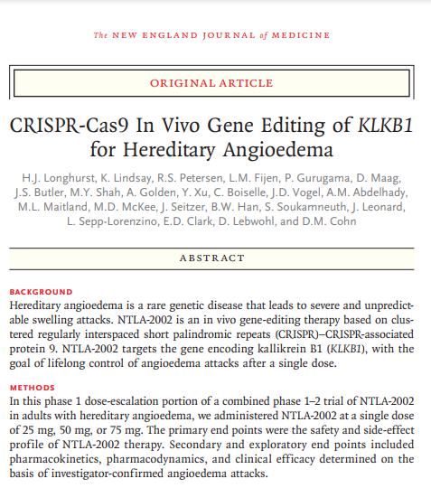
In Vivo Leader: First to Demonstrate Systemic CRISPR Gene Editing in Humans
August 5, 2021
January 31, 2024
Gillmore et al. New England Journal of Medicine 385:493-502 (2021)
Longhurst et al. New England Journal of Medicine 390: 431-441 (2024)

Slide 5
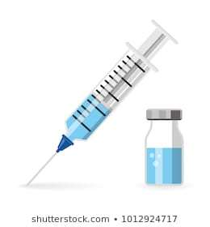
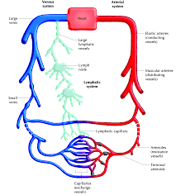
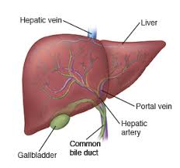
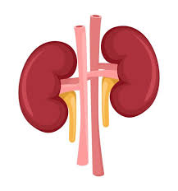
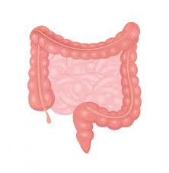
Evaluation of ADME Properties for New Therapeutic Modalities
Bioanalysis for non-clinical and clinical studies
PK, PD, Immunogenicity, and Biomarkers
ADME
Absorption (bioavailability, not needed for IV dosing)
Distribution, Metabolism, and Excretion
Enterohepatic
recirculation
Biliary excretion

Slide 6
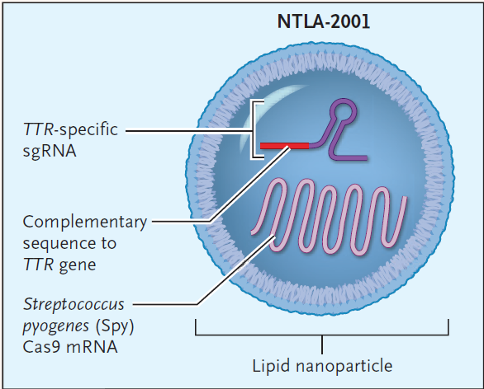
Assessing PK of Novel In Vivo CRISPR/Cas9 Genome Editing Therapies
PK of gene therapy
Four components, as part of the LNP, were quantified to characterize PK
Lipid PK
RNA PK
RNA Drug Substances
Gene-specific sgRNA
Cas9 mRNA
Gillmore et al. New England Journal of Medicine 385:493-502 (2021)

Slide 7
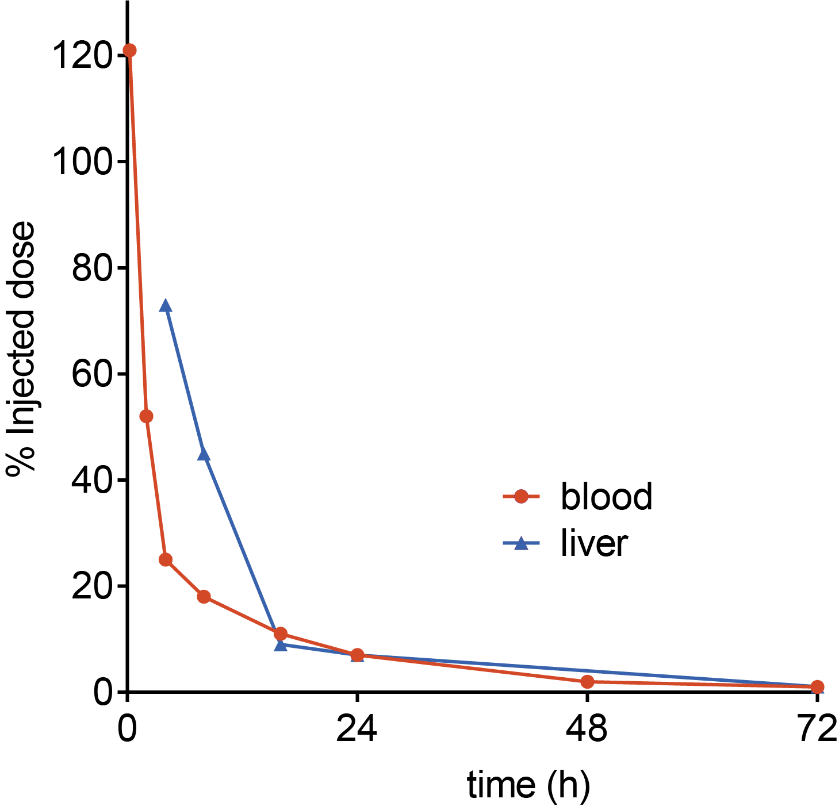
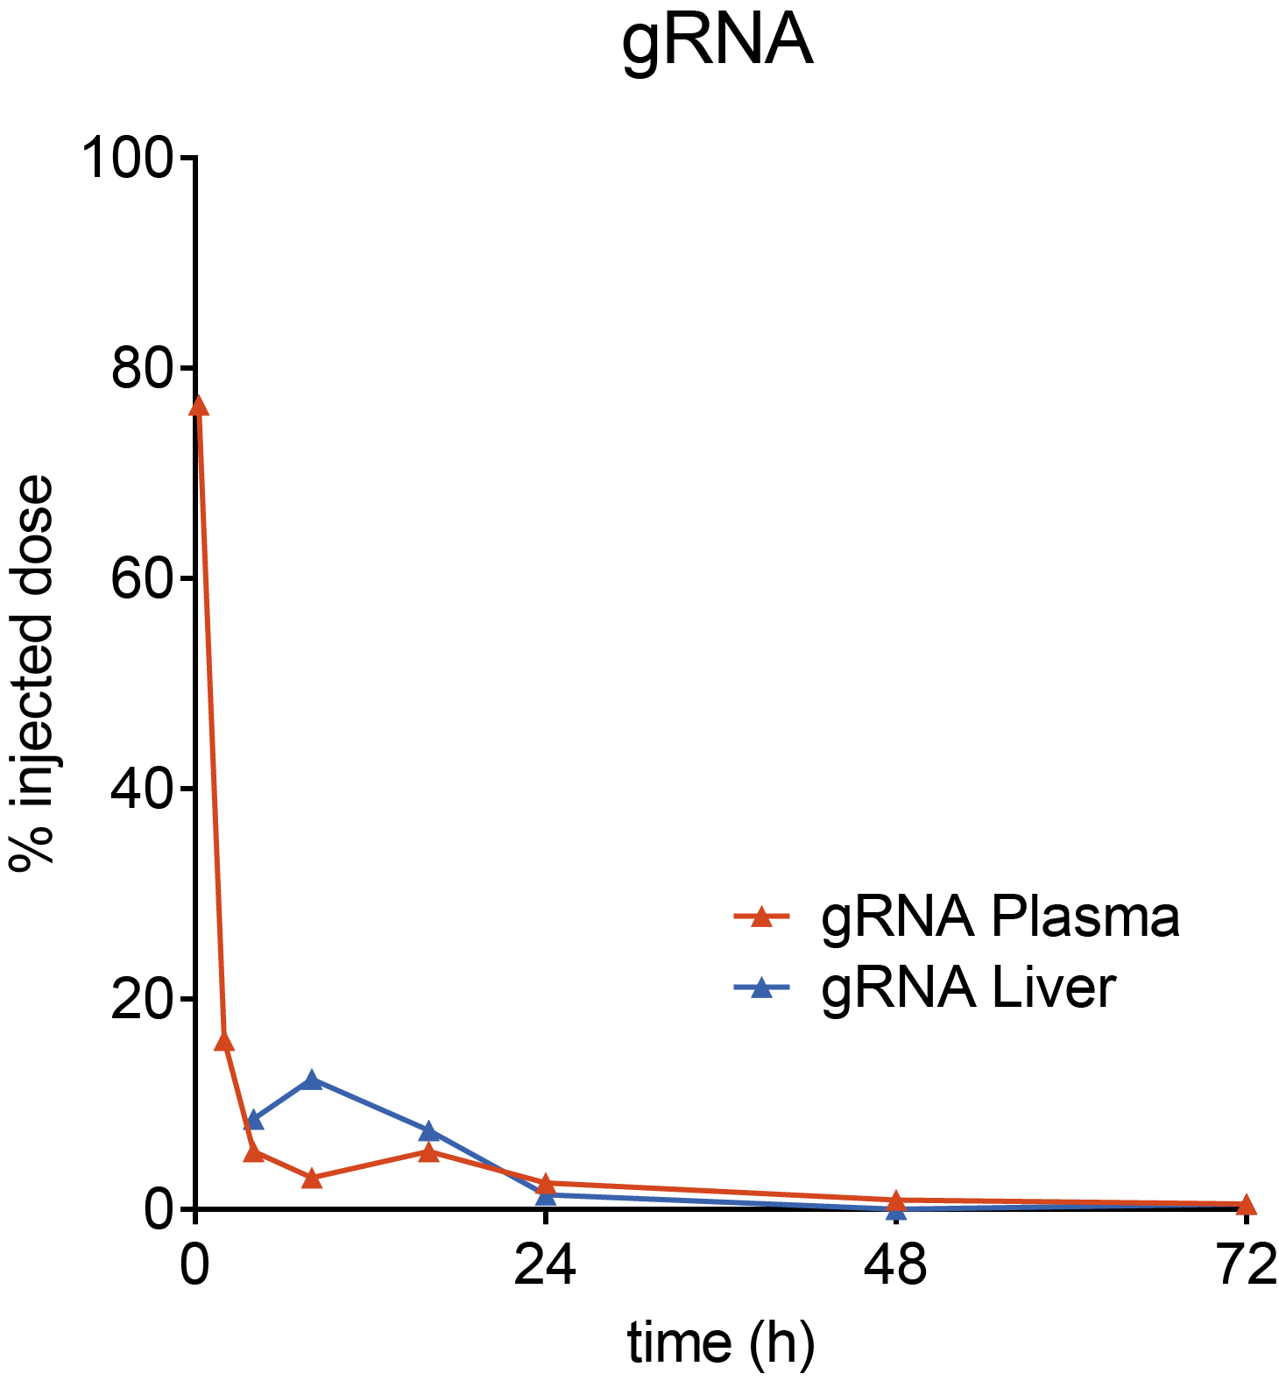
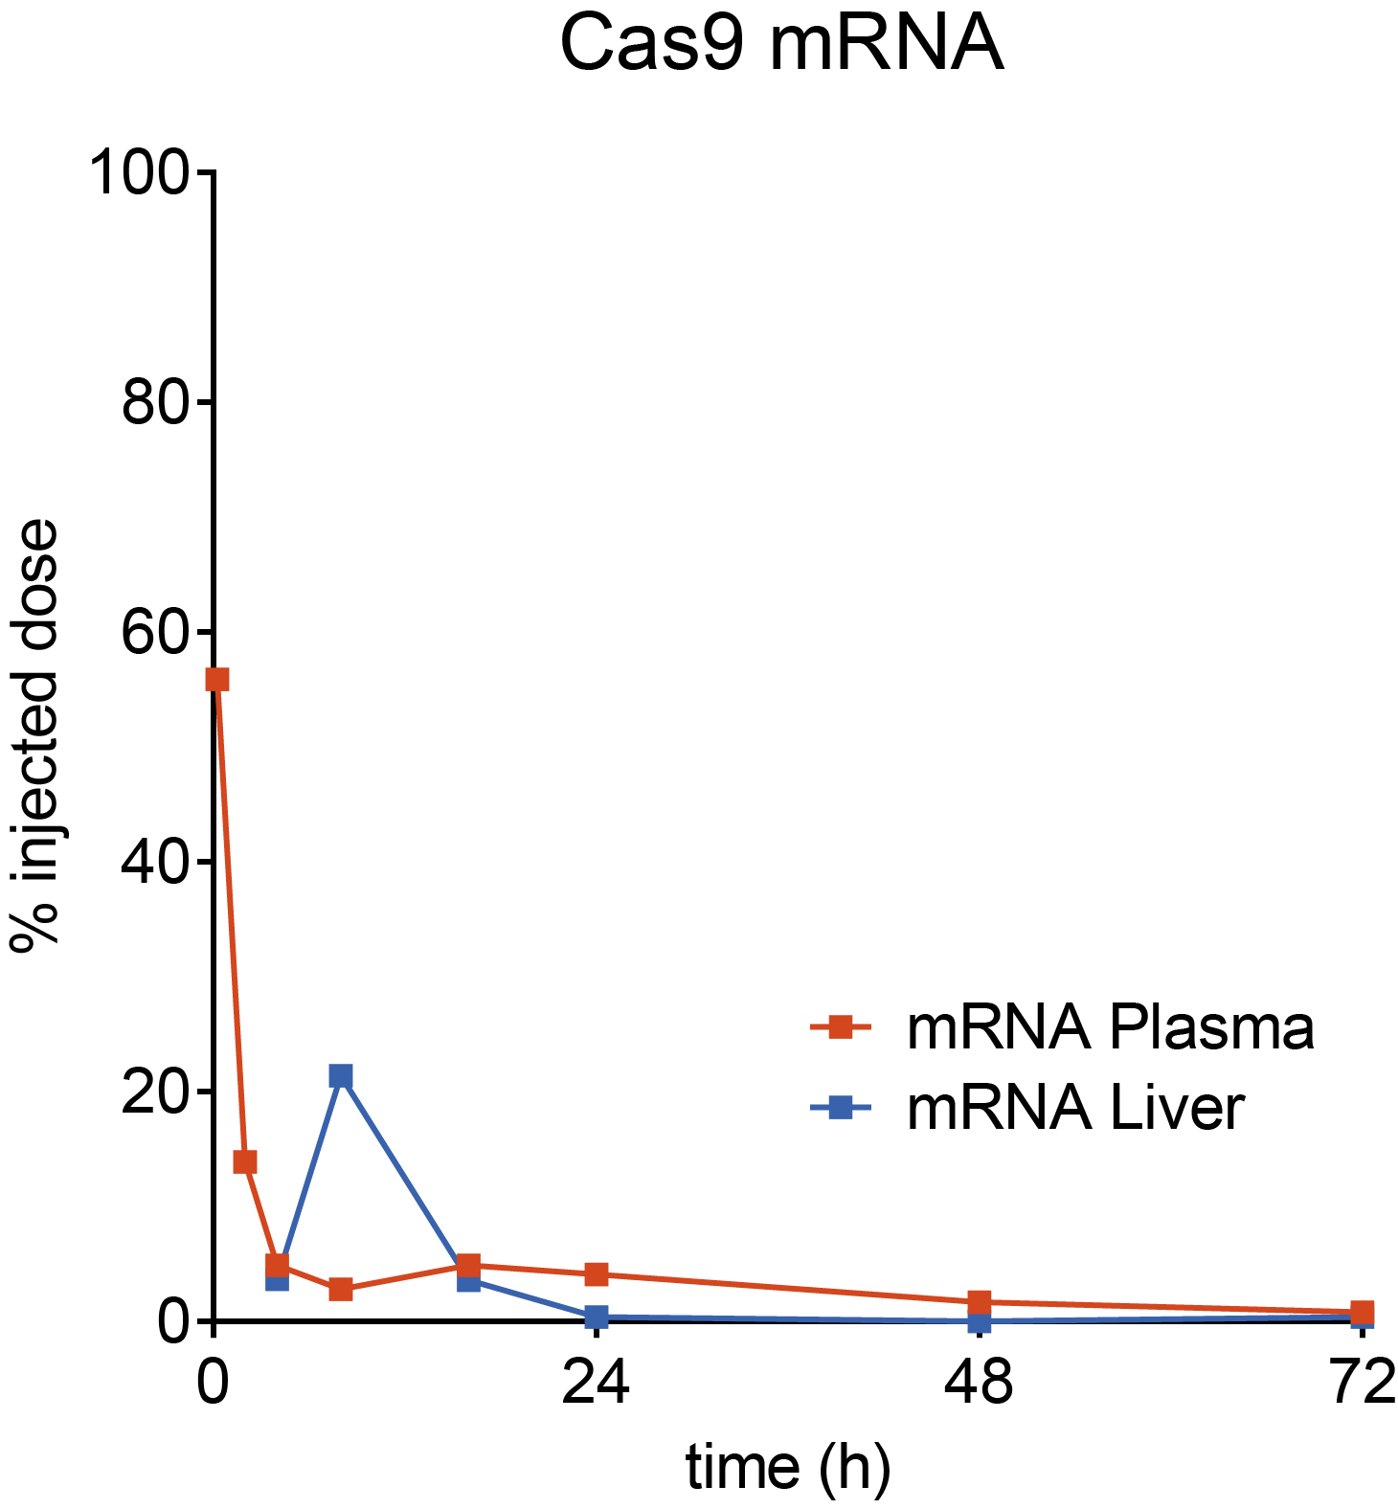
Transient Exposure to LNP and RNA Cargo After Single Administration in NHPs
Ionizable Lipid​
sgRNA
Cas9 mRNA
Lipid Plasma
Lipid Liver

Slide 8
Considerations for Quantitating Oligonucleotides for Bioanalysis
Analysis Technique
Platform Selection
Reagent Needs
Linearity/ Range
Precision/ Accuracy
Limitations
What technique(s) will identify your oligonucleotide?
Are there platform-specific considerations for sample preparation?
Are there platform-specific considerations for reagents (IS; probes; mobile phase additives)?
What is your expected dynamic range? Will multiple dilution schemes be necessary?
Will the technique accurately and precisely measure the analyte concentration with desired sensitivity?
System setup;
Instrument redundancy/ downtime;
Batch/sample set up concerns

Slide 9
Oligonucleotide Quantification Method Landscape, some possibilities
Oligonucleotide Quantification
Amplification
Separation
qPCR/
RT-qPCR
dPCR/ddPCR/
RT-(d)dPCR
Chromatographic Fluorescence Detection
Liquid Chromatography-Mass Spectrometry

Slide 10
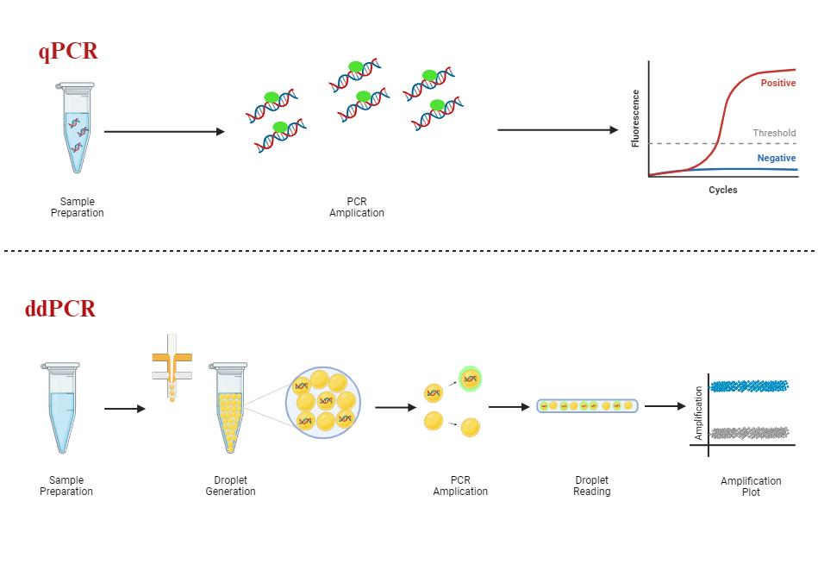
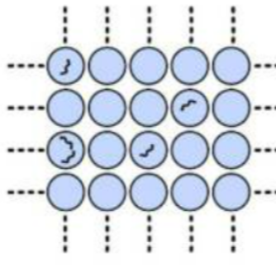
Polymerase Chain Reactions: Mechanism
qPCR
Quantitation: Interpolation of Ct from standard curve
Sample
Preparation
PCR
Amplification
Cycles
ddPCR/
dPCR
Quantitation: copies/rxn (droplet count with Poisson statistics) Interpolation of Ct from standard curve
Sample
Preparation
Droplet
Generation/ Sample Partitioning
PCR
Amplification
Droplet
Reading
Amplification
Plot
Quan et al. Sensors 18(4): 1271-1297 (2018)

Slide 11
Applications of PCR
Cell kinetics for Cell Therapy
Vector shedding for AAV Therapy
Oligonucleotide biodistribution
Transgene expression
Oligonucleotide drug substance pharmacokinetics
Minimal residual disease (oncology)
Other oncology uses: Prognosis, Diagnosis, Response

Slide 12
Cell Kinetics by qPCR
qPCR
YESCARTA® is a CD19-directed genetically modified autologous T cell immunotherapy
Chimeric Antigen Receptor T Cell (CAR-T)
Approved for adults with r/r large B-Cell lymphoma (2L+)
Dose: 2×10⁶ (CAR)-positive viable T cells per kg body weight
Maximum of 2×10⁸ CAR-positive viable T cells
Cell Kinetics by qPCR
Assay LOD: 0.001% (1x10⁻⁵)
Reported units: cells/µl of blood
Matrix: Peripheral blood mononuclear cells
U.S. Food and Drug Administration. Package Insert and Medication Guide YESCARTA. Kite Pharma, Inc. 2024. https://www.fda.gov/media/108377/download

Slide 13
qPCR Cell Kinetics Methodology
qPCR
Unique primer/probe set: Anti-CD19 CAR
DNA Extraction from PBMC
Amplification and Detection
Standards: CAR-T DNA spiked pre-treatment patient DNA
Sample Quantitation by Interpolation to Std Curve and unit conversion
Kochenderfer et al. Blood. 119(12): 2709–2720 (2012).
Locke et al. Molecular Therapy. 25(1): 285-295 (2017).
Locke et al. New England Journal of Medicine. 386: 640-654 (2022).

Slide 14
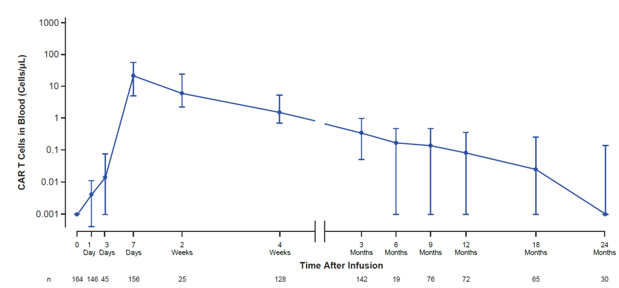
Cell Kinetics of Yescarta® by qPCR Presence, expansion, and persistence in blood
qPCR
qPCR well suited to capture multi-log expansion and contraction, typical of CAR-T therapy
CAR-T cells measured as copies/ug DNA and converted to µL blood (WBC count; # CAR/CAR-T Cell)
CAR T Cells in Blood (Cells/µL)
Time After Infusion
Phase 3, 180 Treated Participants
Locke et al. New England Journal of Medicine. 386: 640-654 (2022).

Slide 15
Vector Shedding and Biodistribution of AAV by qPCR
qPCR
LUXTURNA™ (AAV2-hRPE65) is an adeno-associated virus vector-based gene therapy
Indication: biallelic RPE65 mutation-associated retinal dystrophy
Dose: 1.5x10¹¹ vg/eye (0.3 mL); subretinal injection
Vector Shedding by qPCR
Assay sensitivity: 10 copies/µg DNA
Assay applicability:
Matrices: Fluids and tissues
Species: Human, non-human primate, and dog
U.S. Food and Drug Administration. Package Insert Luxturna. Spark Therapeutics, Inc. 2024. https://fda.gov/media/109906/download.
Swissmedic, Swiss Agency for Therapeutic Products. Swiss Public Assessment Report LUXTURNA. 15 April 2020. https://www.swissmedic.ch/dam/swissmedic/de/dokumente/zulassung/swisspar/67371-luxturna-01-swisspar-20200415.pdf.download.pdf/2020-04-15_SwissPAR_Luxturna-FINAL.pdf

Slide 16
Nonclinical Biodistribution of AAV by qPCR PCR is well suited for analysis from multiple matrices (DNA extraction)
qPCR
Dog
AAV Detected in multiple organs
Non-human primate
AAV Detected in multiple organs
Subretinal injection
Subretinal injection
Eye: Vitreous and anterior chamber fluids
Eye
Timepoints: 3 weeks and 3 months post dose
Timepoint: 3 months post dose
Optic Nerve
Preauricular lymph nodes
Various lymph nodes
Colon, duodenum, stomach
Optic nerve
Liver
Spleen
Technical challenges for liver and lung, N/A
Trachea
BQL: Gonads
U.S. Food and Drug Administration. Package Insert Luxturna. Spark Therapeutics, Inc. 2024. https://fda.gov/media/109906/download.
Swissmedic, Swiss Agency for Therapeutic Products. Swiss Public Assessment Report LUXTURNA. 15 April 2020. https://www.swissmedic.ch/dam/swissmedic/de/dokumente/zulassung/swisspar/67371-luxturna-01-swisspar-20200415.pdf.download.pdf/2020-04-15_SwissPAR_Luxturna-FINAL.pdf

Slide 17
Clinical Vector Shedding of AAV by qPCR
qPCR
Systemic exposure (serum pos) seen from some patients after subretinal injection
Assay principles remain the same from nonclinical to clinical use
 | Unilateral Injection |  |  | Bilateral Injection
 | Injected Eye | Un-injected Eye
Tears | 45% of Subjects: low, transient levels | 7% of Subjects: positive until Day 3 |  | 45% of Subjects: vector detected Day 1
 |  |  |  | Majority had no detectable DNA by Day 3
Serum |  |  |  | 10% of Subjects: positive
U.S. Food and Drug Administration. Package Insert Luxturna. Spark Therapeutics, Inc. 2024. https://fda.gov/media/109906/download.

Slide 18
qPCR or dPCR? Benefits and Challenges
qPCR
dPCR
Dynamic Range | 8+ Log₁₀ | 4 Log₁₀; lower ULOQ
Sensitivity/rare event quantitation | High | Very High
Quantitation | Std Curve Interpolation (R² and Slope criteria) | Absolute (droplet count with Poisson statistics)
Plate format | 384 | 24 up to 96*4
Detectable Foldchange | 1.25-1.50x | 1.2x
Susceptible to PCR inhibition | Higher | Lower
Amplification Reliance | Higher | Lower
Precision | High | Very high
Dilution Linearity | Good | Very good
Industry Comfort for Validated Assays | High | Good, growing
Robustness | High | Good
Instrument Validation Comfort | High | Good, growing
Hays et al. The AAPS Journal 26(24):1-31 (2024); Corsaro et al. Bioanalysis 13(6): 415-463 (2021); Pan et al. Bioanalysis 15(14): 773-814 (2023); Loo et al. Bioanalysis 14(11): 737-793 (2022); Wissel et al. Bioanalysis 14(12): 853-863 (2022); Huggett et al. Clinical Chemistry 59(6): 892–902 (2013)

Slide 19
Overarching PCR Themes qPCR and dPCR Considerations
qPCR
&
dPCR
QCs (High, Mid, Low) and NTC
Reverse-transcription workflows available
Primers and probes are critical reagents and should be purified and nuclease free
LLOQ <50 copies/ug gDNA
Copy No./ug nucleic acid reported generally; but copy/volume matrix could be used with justification (copy/µL blood for cell kinetics)
NTC (water wells) and blank matrix/background DNA/RNA should be tested
Interference with multiplexing possible, define variability separately
Restriction enzymes may improve quantitation
Sample preparation similar for tissue homogenization/cell lysis/DNA extraction
Similar validation plans, but criteria will be platform dependent
Hays et al. The AAPS Journal 26(24):1-31 (2024); Corsaro et al. Bioanalysis 13(6): 415-463 (2021); Pan et al. Bioanalysis 15(14): 773-814 (2023); Wissel et al. Bioanalysis 14(12): 853-863 (2022); Huggett et al. Clinical Chemistry 59(6): 892–902 (2013); Sun et al. Bioanalysis 15(17):1069-1081 (2023)

Slide 20
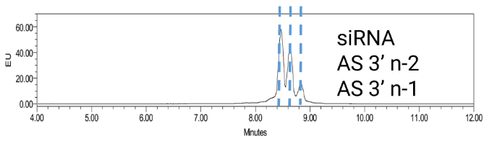

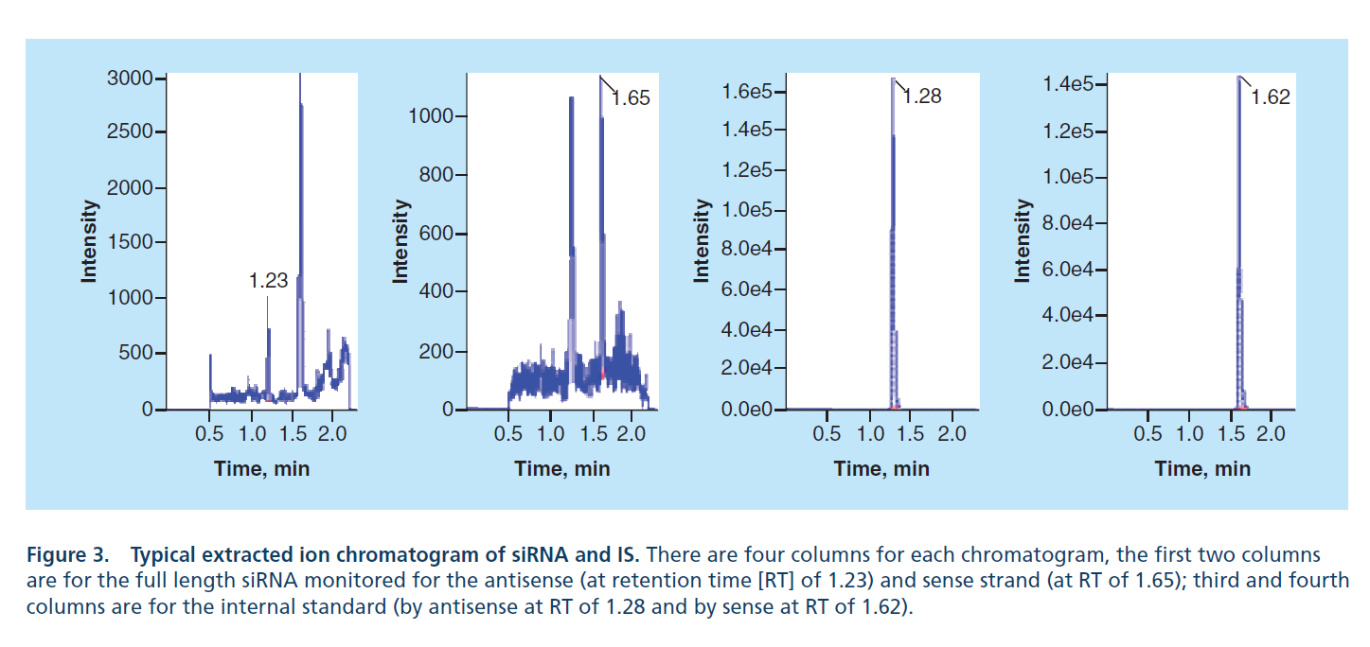

Chromatographic Separation and Analysis
Fluorescence Signal with chromatographic separation from metabolites (n-1, n-2)
Chromatographic Fluorescence Detection
Quantitation: Interpolation from standard curve
Sample
Preparation
Probe Binding
LC-Fluorescence
Analyte
Internal Standard
LC-MS
Quantitation: Interpolation from standard curve; IS correction
Sample
Preparation
IS Addition and Oligonucleotide Extraction
LC-MS (High Res)
Ramanathan and shen. Bioanalysis 11(21): 1983–1992 (2019);
Wuxi Apptec. Application of Liquid Chromatography-Fluorescence (LC-FL) Detection Methods for DMPK Quantitative Bioanalysis of Oligonucleotides. 2023. https://dmpkservice.wuxiapptec.com/articles/21-application-of-liquid-chromatography-fluorescence-lc-fl-detection-methods-for-dmpk-quantitative-bioanalysis-of-oligonucleotides/

Slide 21
Pharmacokinetics by ATTO-probe/ HPLC-Fluorescence Detection
Chromatographic Fluorescence Detection
ONPATTRO® (patisiran) is a lipid complex injection, for intravenous use
Approved for adults with ATTR-PN
Small interfering RNA Drug Substance (ALN-18328)
Dose: 0.3 mg/kg up to 30 mg; every 3 weeks by intravenous infusion
PK by Fluorescence Detection
Limit of quantification (LLOQ): 1 ng/mL
Precision (CV%): 9.1%
Accuracy Range: -2.7%-2.5%
U.S. Food and Drug Administration. Label Onpattro. Alnylam Pharmaceuticals, Inc. 2018. https://www.accessdata.fda.gov/drugsatfda_docs/label/2018/210922s000lbl.pdf

Slide 22
Fluorescence Methodology
Chromatographic Fluorescence Detection
Unique probe: Complementary to strand of interest
Plasma Preparation
Probe Annealing
Separation and detection: ion exchange HPLC and fluorescence
Sample Quantitation by Interpolation to Std Curve
Zhang et al. The Journal of Clinical Pharmacology., 60(1) 37–49 (2020); Coelho et al. New England Journal of Medicine. 369(9):819-829 (2013).

Slide 23
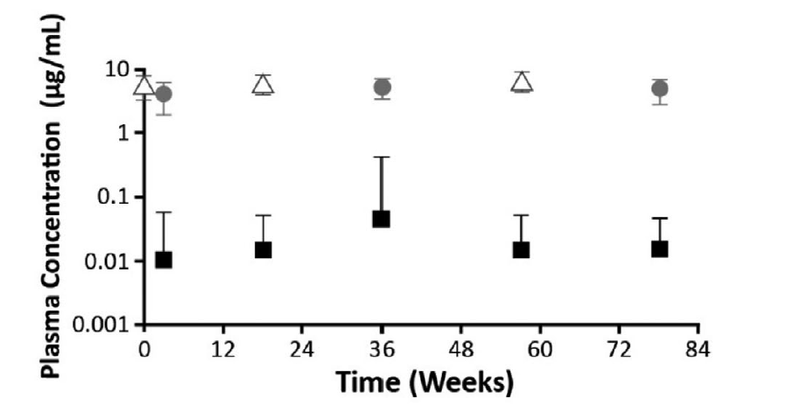
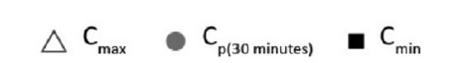
Drug Substance Pharmacokinetics by Fluorescence
Chromatographic Fluorescence Detection
Chromatographic separation allows for detection of the full-length oligonucleotide without n-1/ n-x metabolites
Dynamic range covers peak (C_{max}) and trough (C_{min}/Predose) concentrations
End of Infusion
30-min post end of infusion
Predose
Phase 3: 148 Treated Participants
Zhang et al. The Journal of Clinical Pharmacology., 60(1) 37–49 (2020)

Slide 24
Oligonucleotide Pharmacokinetics by Mass Spectrometry
LC-MS
Proof of principle validation in NHP plasma
Validation of Quantitation by LC-MS; high resolution TOF
Limit of quantification (LLOQ): 10 ng/mL
Linearity: 10-10,000 ng/mL
Precision, Accuracy: ±15% from nominal; ±20% for LLOQ
Recovery: >90%; Matrix Effect: <15% CV
Dilution: at 200x, recovery ±15% from nominal, <15% CV
Stability: 5 F/T; 1-year long term
Column carryover monitored and column injection limit imposed
Effect of hemolysis tested
MS Data Capture: Acquisition of full scan spectra and the summation of multiple ions by extracted ion chromatogram for quantitation (analyte and IS)
Two charge states selected for quantitation
Response: peak area of the 10 most intense ions per species
M/Z separation does not require chromatographic separation of species
Ramanathan and Shen. Bioanalysis 11(21): 1983–1992 (2019);

Slide 25
LC-MS Methodology
LC-MS
Internal Standard Addition and Oligo Extraction from Plasma
Evaporation and Reconstituted in LC-MS compatible solvents
RPLC and HR MS Analysis
Peak Detection
Sample Quantitation by Interpolation to Std Curve and IS normalization
Ramanathan and Shen. Bioanalysis 11(21): 1983–1992 (2019);
Wuxi Apptec. Application of Liquid Chromatography-Fluorescence (LC-FL) Detection Methods for DMPK Quantitative Bioanalysis of Oligonucleotides. 2023. https://dmpkservice.wuxiapptec.com/articles/21-application-of-liquid-chromatography-fluorescence-lc-fl-detection-methods-for-dmpk-quantitative-bioanalysis-of-oligonucleotides/

Slide 26
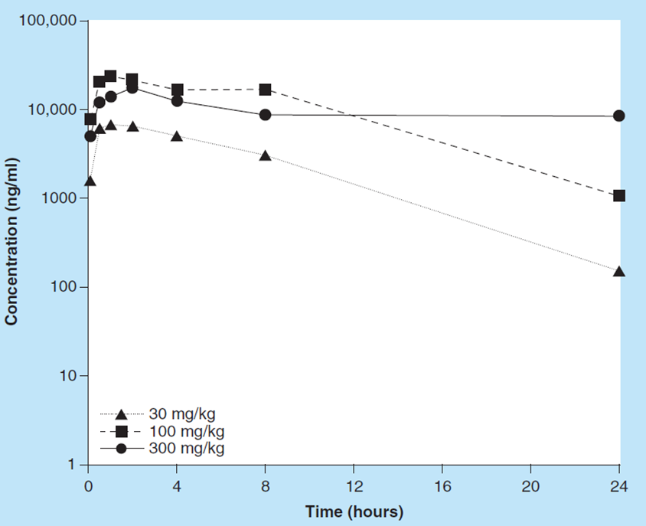
NHP Pharmacokinetics measured by LC-MS Oligonucleotide plasma concentration
LC-MS
Mass confirmed identity of analyte
Matrix: Plasma; Limit of quantification (LLOQ): 10 ng/mL
Dosing: Subcutaneous
Ramanathan and Shen. Bioanalysis 11(21): 1983–1992 (2019)

Slide 27
LC-Fluorescence vs LC-MS
Chromatographic Fluorescence Detection
LC-MS
(High-Res)
Standard curve and QCs | Yes | Yes
Complementary probe | Yes | No
Internal standard (run to run variability correction) | No | Yes
Known metabolite separation/characterization | Yes | Yes
New metabolite identification | No | Yes (HR/AS needed for N-1)
Gradient, mobile phase, and ion pairing agent (MS) optimization | Yes | Yes
Validation criteria can be applied, or justified if different, from small molecule or LBA criteria Accuracy and precision: %bias/%CV at 15% (LLOQ 20%); %bias/%CV at 20% (LLOQ 25%) | Yes | Yes
Donegan et al. Journal of Chromatography A. 1666(462860):1-12 (2022). Pan et al. Bioanalysis 15(14): 773-814 (2023). Sutton et al. Journal of the American Society for Mass Spectrometry 31(9): 1775-1782 (2020).
Birdsall et al. Waters Corporation. Factors Influencing Diastereomer Separations in Oligonucleotide Analysis. 2019. https://www.waters.com/content/dam/waters/en/app-notes/2017/720005978/720005978-en.pdf

Slide 28
Oligonucleotide Quantification Method Landscape, some possibilities
qPCR
Well established, large dynamic range
Specific primers/probe required; amplicon must be >~ 60 bases
May detect metabolites, depending on amplicon
dPCR
Very sensitive, smaller dynamic range
Specific primers/probe required; amplicon must be >~ 60 bases
May detect metabolites, depending on amplicon
Chromatographic Fluorescence Detection
Well established
Specific probe required for fluorescence-based detection
Metabolite separation possible
LC-MS or LC-MS/MS
Established instrumentation, oligo-specific extraction/mobile phases necessary
Quantitation by full scan requires summation across multiple peaks
Unique M/Z detection may allow for less chromatographic optimization
Other Instrumentation
BDNA (larger target, not the preferred method due to challenges)
Stem-loop PCR (if oligo is too short for traditional PCR)
Hybridization ELISA (using complementary oligo-based capture and detection)

Slide 29
Overall platform considerations
Is your sequence PCR “friendly”? GC-content/length/modifications
No standard curve ≠ no QCs
Are there any special software considerations?
What is your MS Internal Standard? Is your mobile phase stable?
Do you have instrumentation for the long term?
Will N-1 metabolites be measured? Is that acceptable?
Are preparation complexities prohibitive?

Slide 30
Conclusions
Technical platform selection is based on method context of use
Before making a selection, consider desired assay performance attributes
Analytical sensitivity (if dose levels are low)
Accuracy and precision
Reagent availability and stability (such as antibody-based assays)
Resolution if HPLC, LC-MS, or LC-MS/MS based without "shoulders and tails" in chromatograms
Understanding the drug product is critical, especially if the drug has multiple components such as CAR-T, LNP, and conjugated ASO (antisense oligonucleotide) or siRNA (small interfering RNA)
Think ahead as much as possible: Decisions made early in a program lifecycle can have implications for years to come (assay, reagent, site/laboratory comparability)

